Slide 1


Empirical Security & Privacy, for Humans
UPenn CIS 7000-010
Michael Hicks
Introduction

Slide 2
How would you answer this question?
In the last decade, has the security of computer systems, generally,
improved,
declined, or
stayed the same?

Slide 3
A story of memory (un)safety

Slide 4
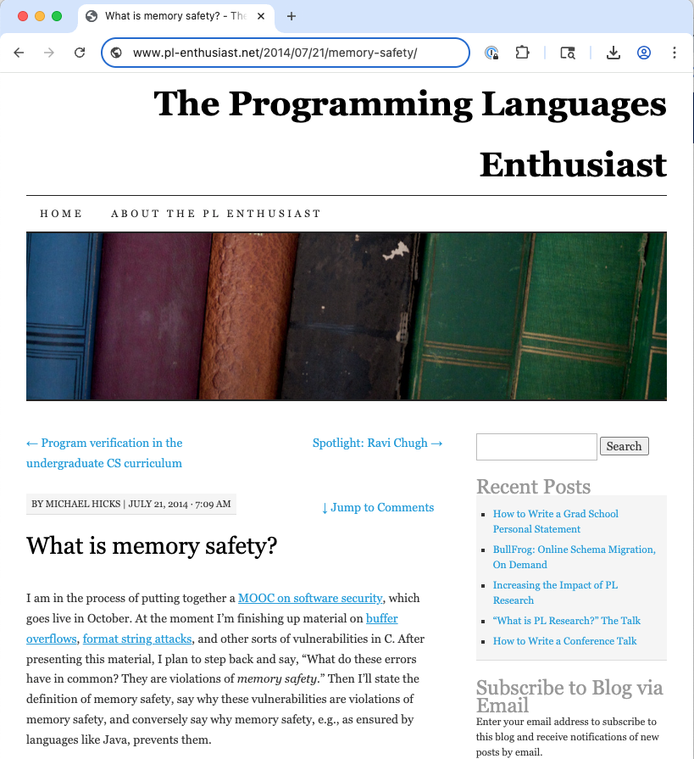

Slide 5
Violations of memory safety
Spatial
Buffer overflow (heap or stack, read or write)
Temporal
Use after free
Use of uninitialized memory
Other (maybe)
Wild pointer deference (int to pointer, deref)
Type confusion (bad cast, deref)

Slide 6
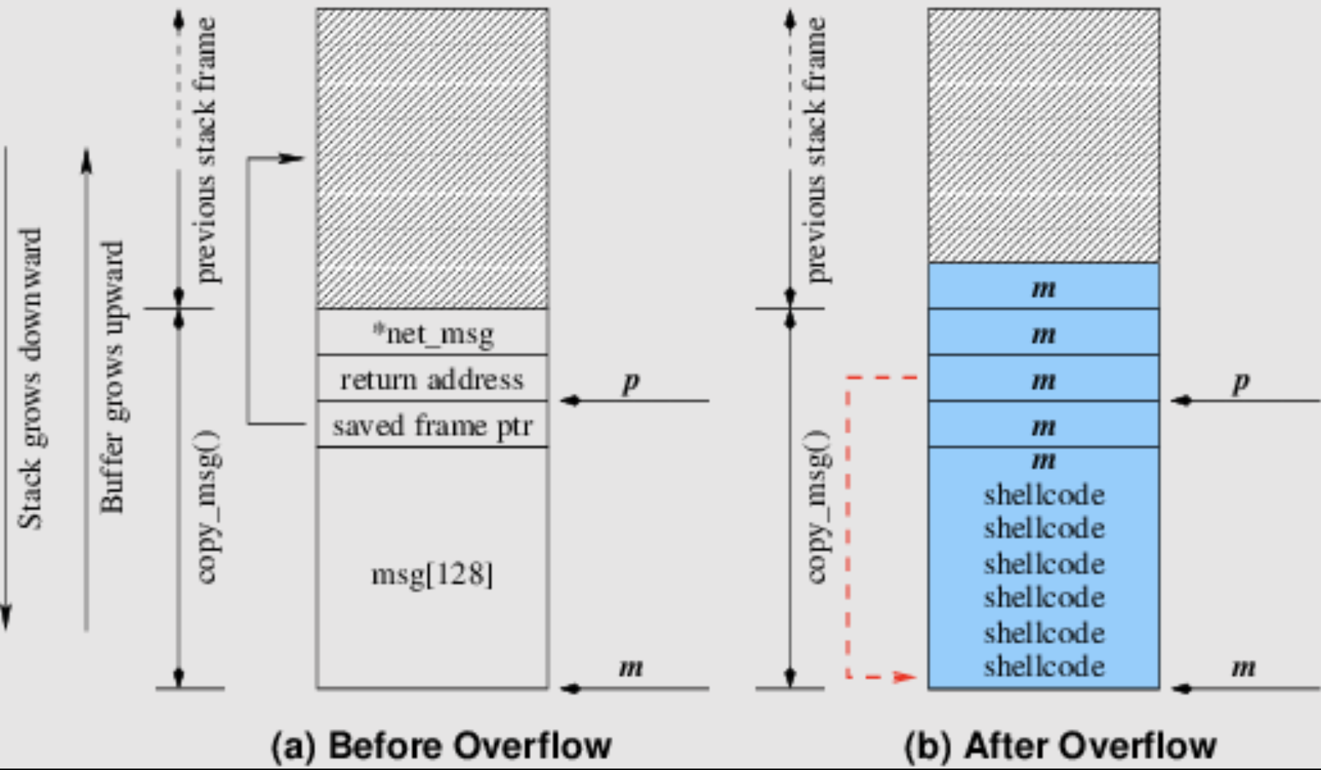

Slide 7
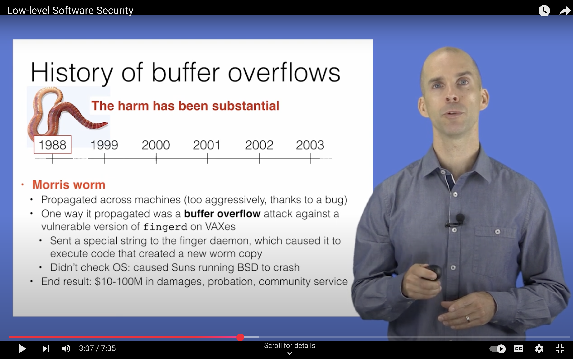
Code Red
SQL Slammer
https://www.youtube.com/watch?v=3BqiTEwz1I0
Notes:
Code Red exploited overflow in MS-IIS server; 300k machines affected in 14 hours
SQL Slammer exploited an overflow in the MS-SQL server; 75k machines affected in 10 minutes

Slide 8
What to do? Some options
Write C/C++ code without (or with fewer of) these bugs in it
Write C/C++ code without (or with fewer of) these bugs in it
Write code in a memory safe language
Leverage compiler and OS-level mitigations that
make the bugs more difficult to exploit, and/or
limit the damage/scope of an exploitation

Slide 9
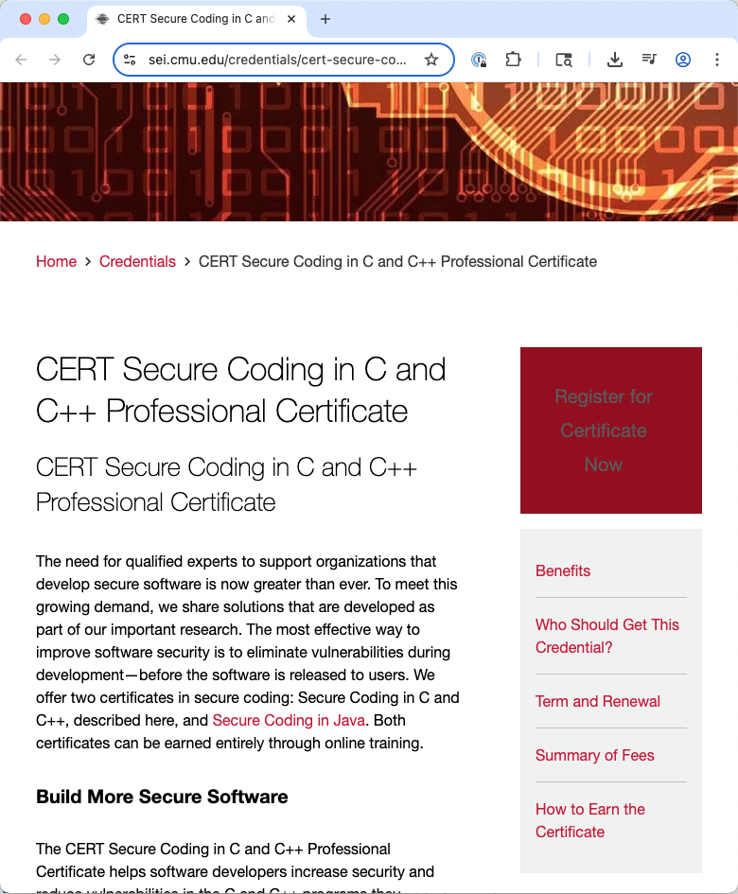
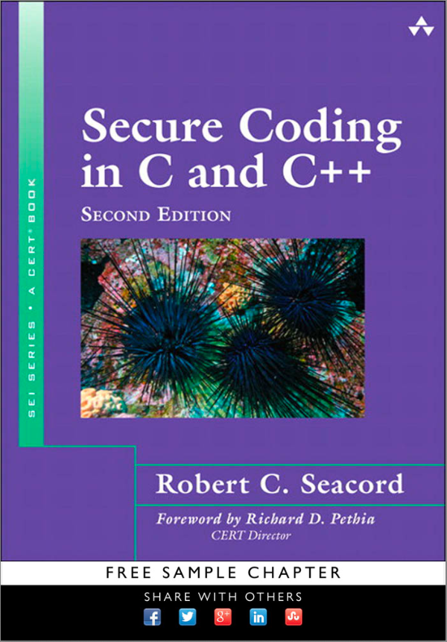
Write C/C++ code without (or with fewer of) these bugs in it

Slide 10
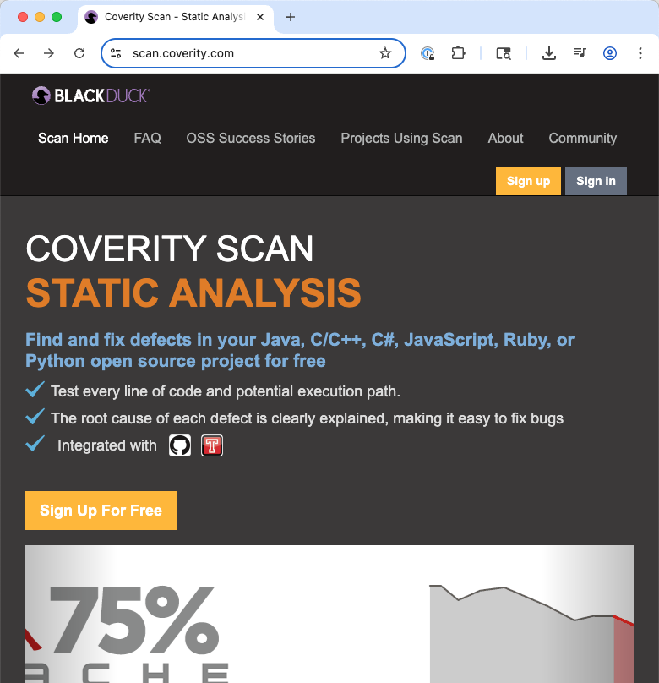
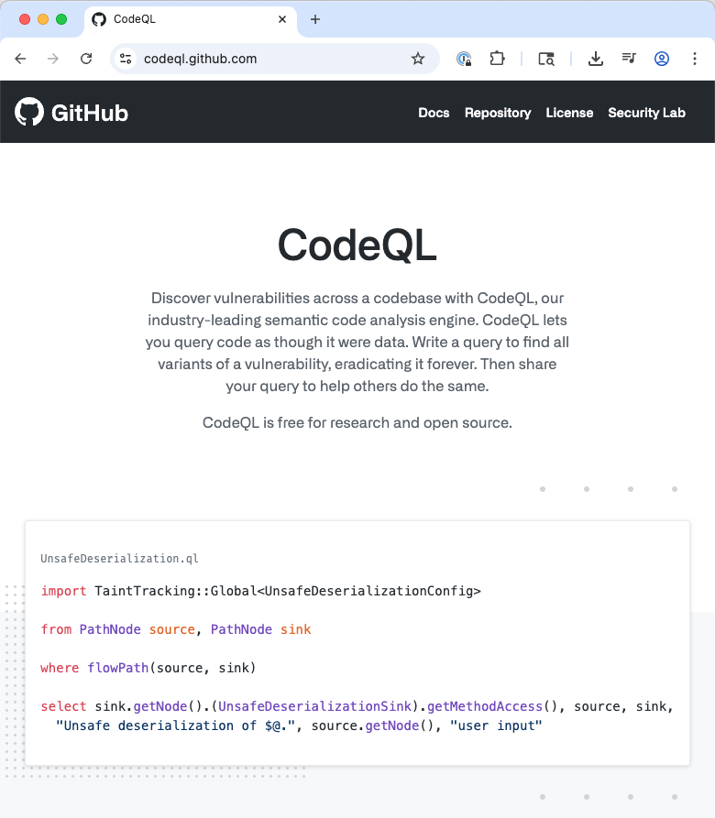
Write C/C++ code without (or with fewer of) these bugs in it

Slide 11
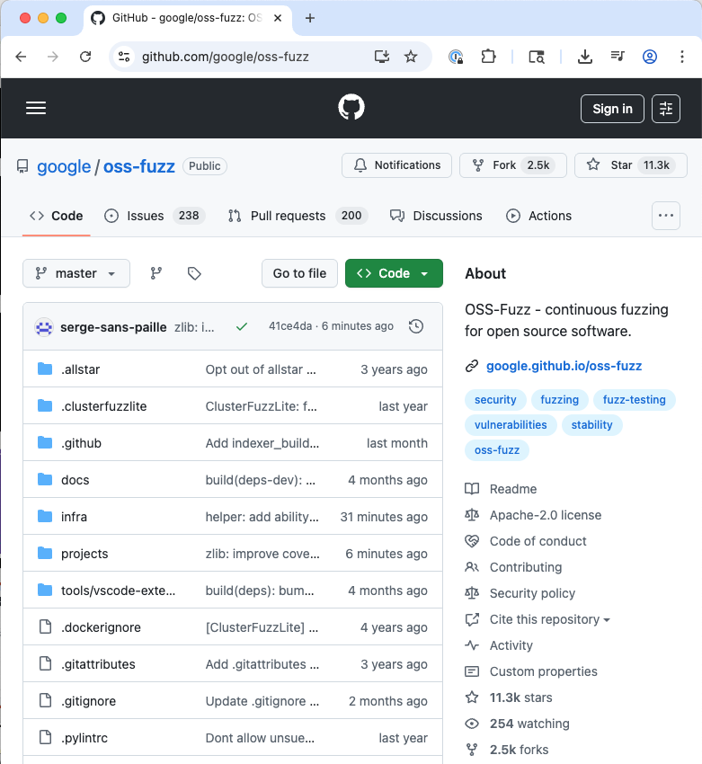
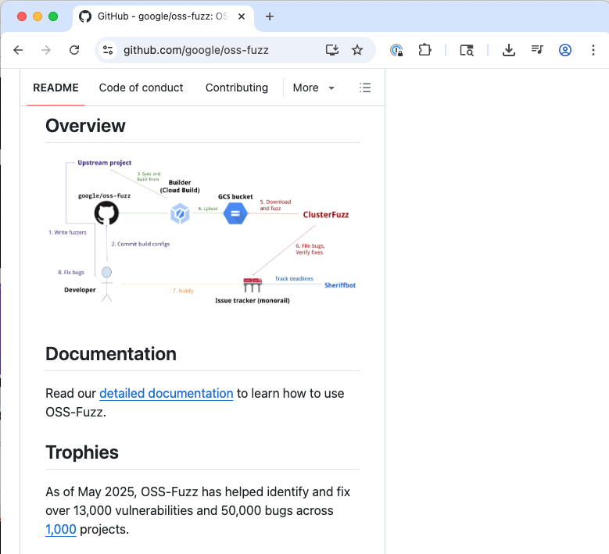
Write C/C++ code without (or with fewer of) these bugs in it

Slide 12
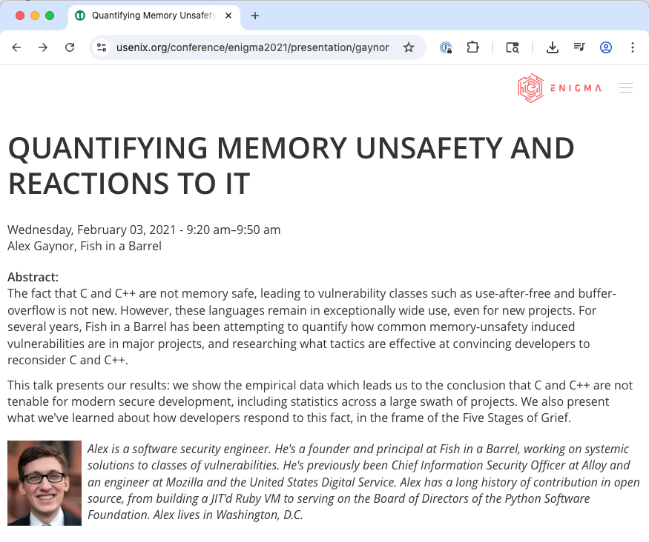
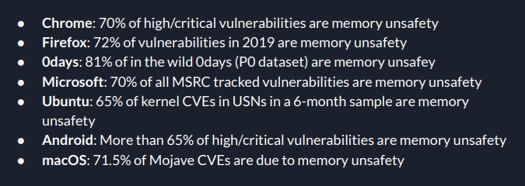
How’s that going?

Slide 13
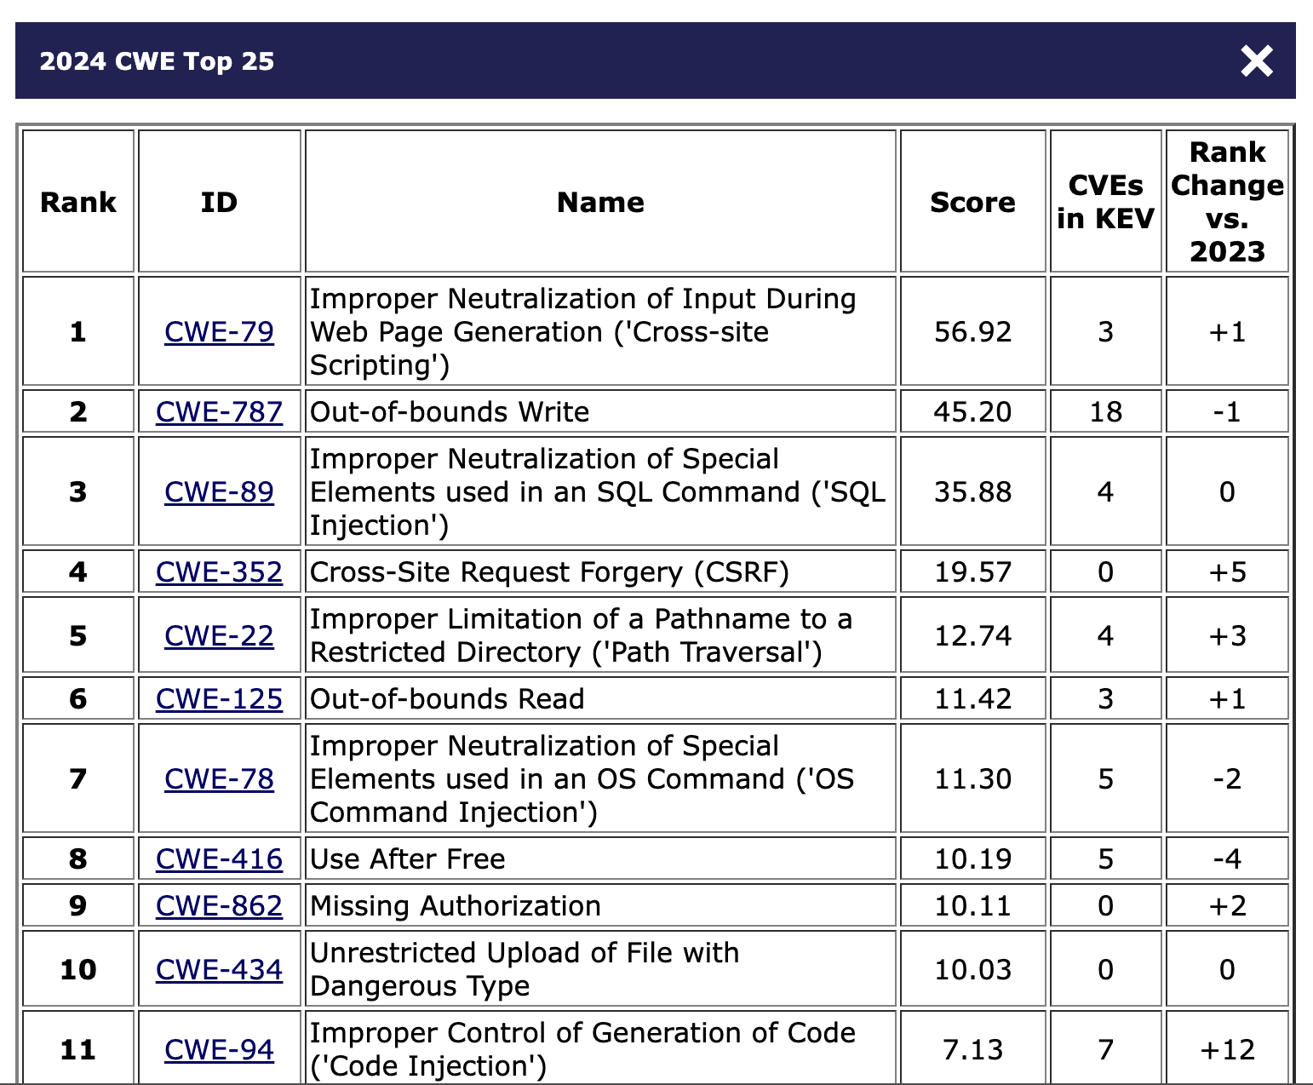
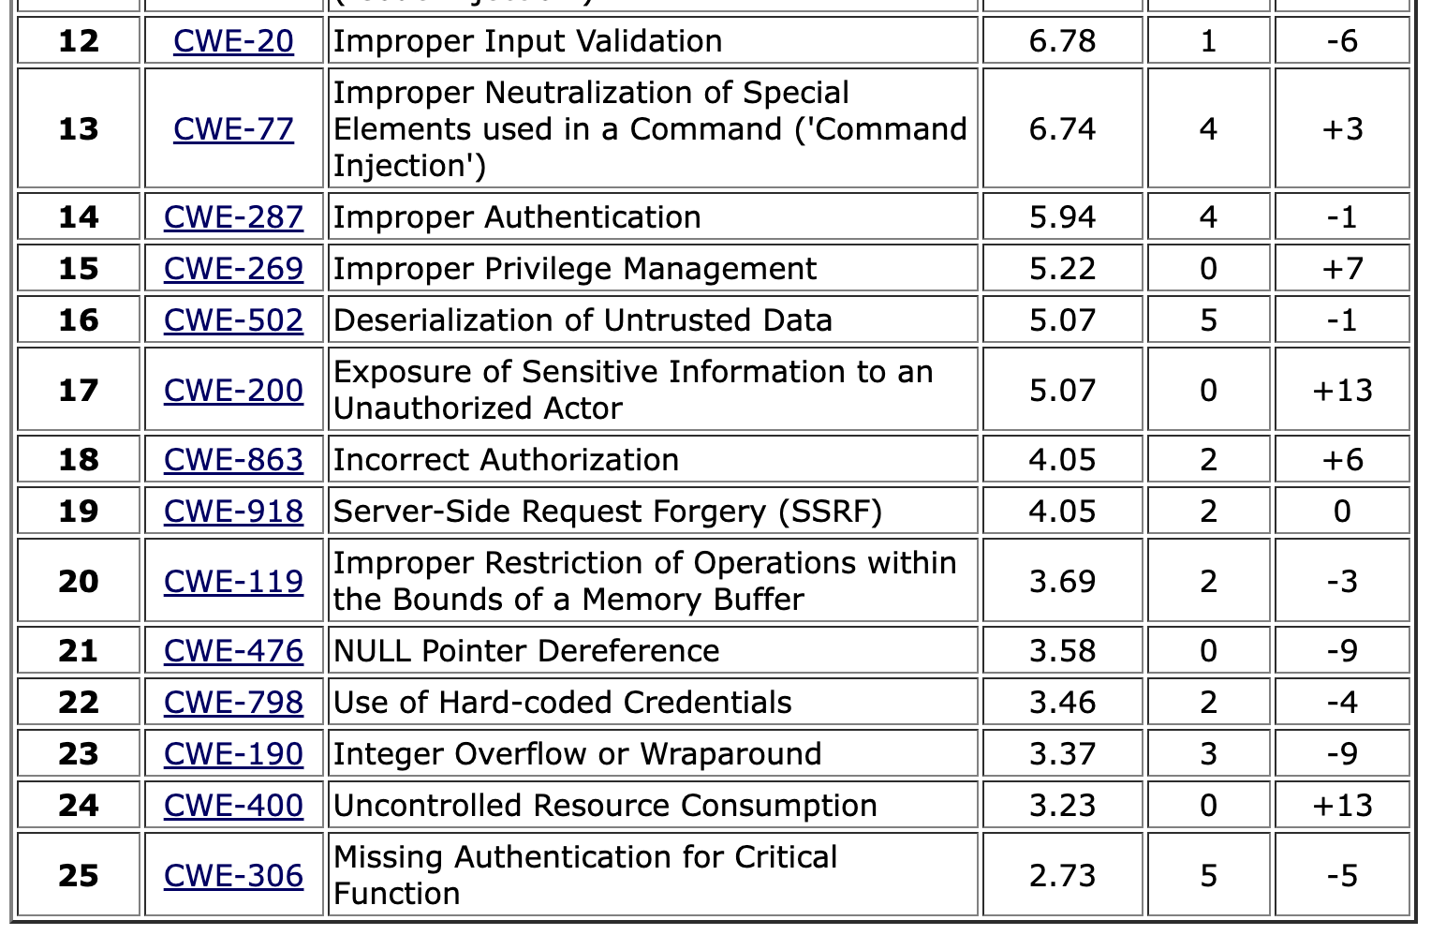
How’s that going?
Classic memory-safety vulnerabilities
https://cwe.mitre.org/top25/archive/2024/2024_cwe_top25.html
Notes:
This year’s dataset included 31,770 CVE Records for vulnerabilities published between June 1, 2023 and June 1, 2024. Data was initially pulled on July 30, 2024, to share with CNA community partners for review. Data was pulled again on November 4, 2024, to ensure the most up to date CVE Records information was used in the Top 25 list calculations.
https://cwe.mitre.org/top25/archive/2024/2024_methodology.html
Note: CVSS scores are between 0 and 10
Beyond Trust CVEs
https://nvd.nist.gov/vuln/detail/cve-2024-12356 (Command Injection, 9.8 CVSS) to BeyondTrust Privileged Remote Access (PRA)
https://nvd.nist.gov/vuln/detail/CVE-2024-12686 (Command Injection 7/2 CVSS) BeyondTrust Privileged Remote Access (PRA) and Remote Support (RS) OS Command Injection Vulnerability

Slide 14
What to do? Some options
Write C/C++ code without (or with fewer of) these bugs in it
Write code in a memory safe language
Leverage compiler and OS-level mitigations that
make the bugs more difficult to exploit, and/or
limit the damage/scope of an exploitation
Write code in a memory safe language

Slide 15
Write code in a memory safe language
Memory safe:
Rust
Swift
Go
Haskell
Python
Etc.
Memory unsafe:
C
C++
Assembly

Slide 16
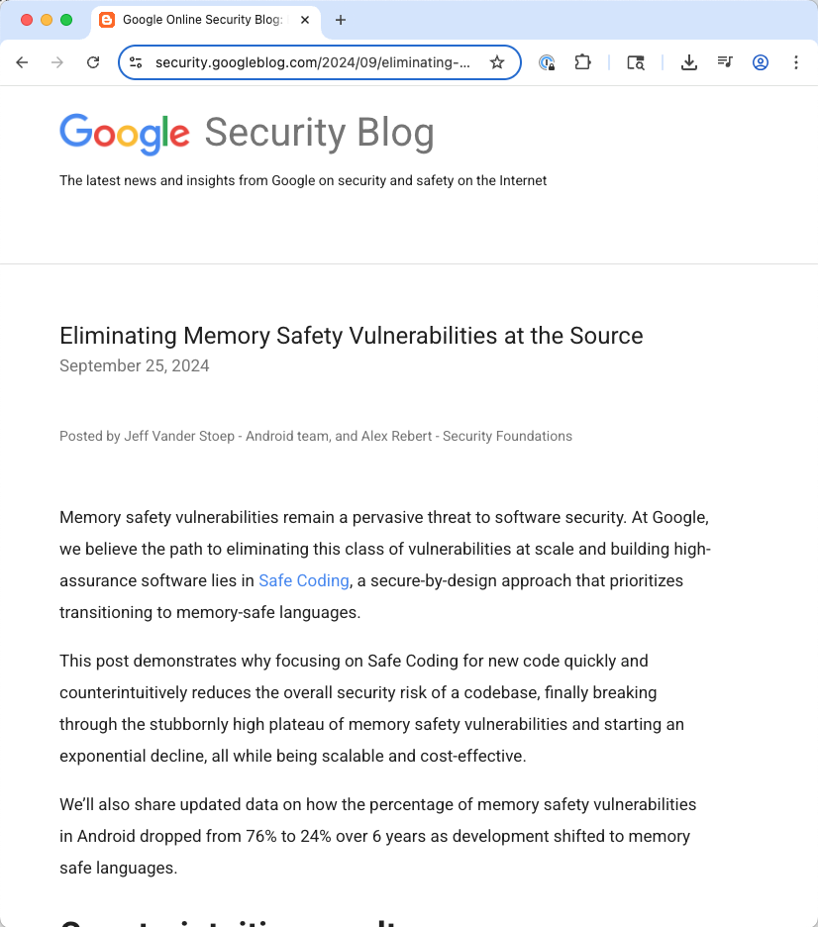
How’s that going?
the percentage of memory safety vulnerabilities in Android dropped from 76% to 24% over 6 years as development shifted to memory safe languages

Slide 17
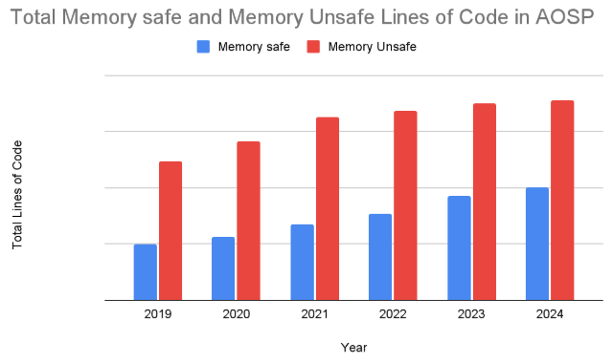
How’s that going?

Slide 18
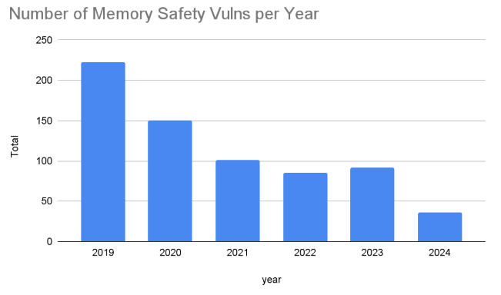
How’s that going?

Slide 19
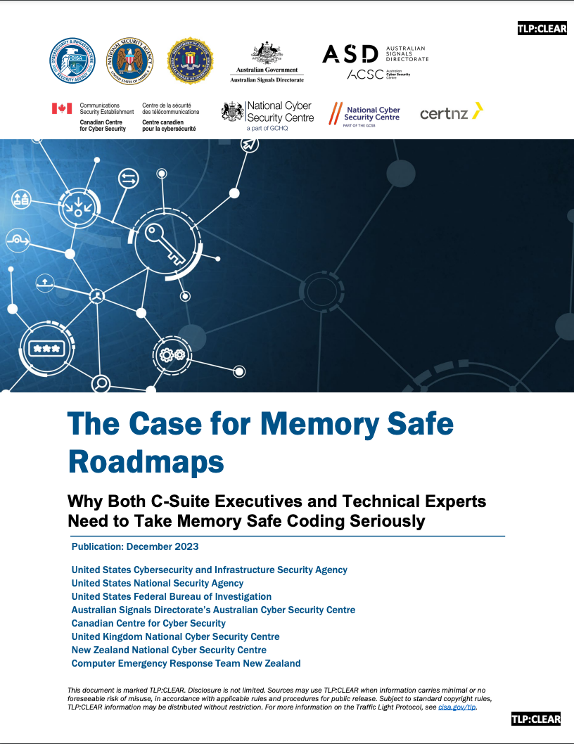
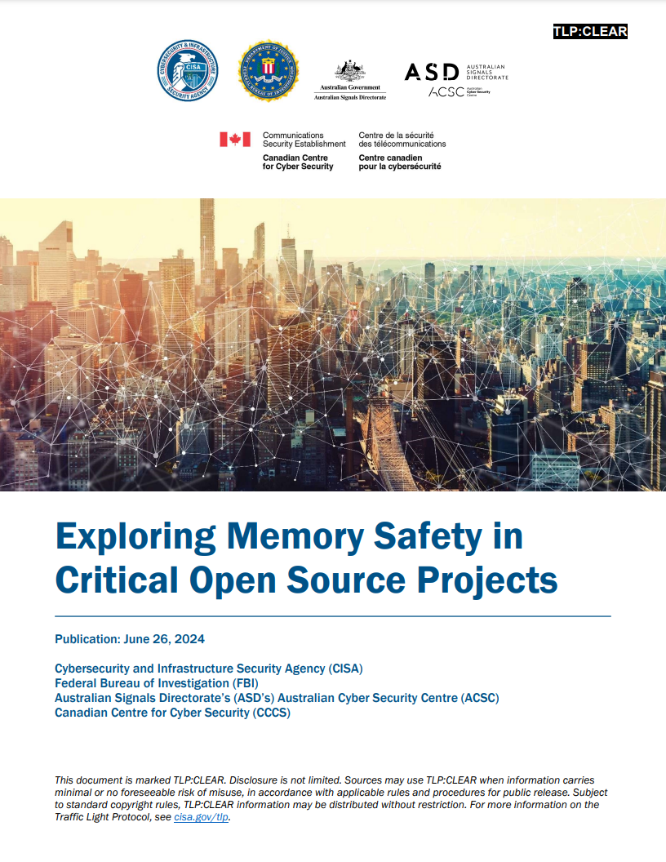
December 2023
June 2024

Slide 20
What to do? Some options
Write C/C++ code without (or with fewer of) these bugs in it
Write code in a memory safe language
Leverage compiler and OS-level mitigations that
make the bugs more difficult to exploit, and/or
limit the damage/scope of an exploitation
Leverage compiler and OS-level mitigations that
make the bugs more difficult to exploit, and/or
limit the damage/scope of an exploitation

Slide 21
Leverage compiler and OS-level mitigations that
make the bugs more difficult to exploit, and/or
limit the damage/scope of an exploitation
Challenge exploitability:
Stack canaries
Address-space layout randomization (ASLR)
“write xor execute” (W⊕X)
Control-flow integrity (CFI)
Etc.
Limit damage:
Process-level isolation
Within-process compartments (eg., RLbox)
Externally enforced access control

Slide 22
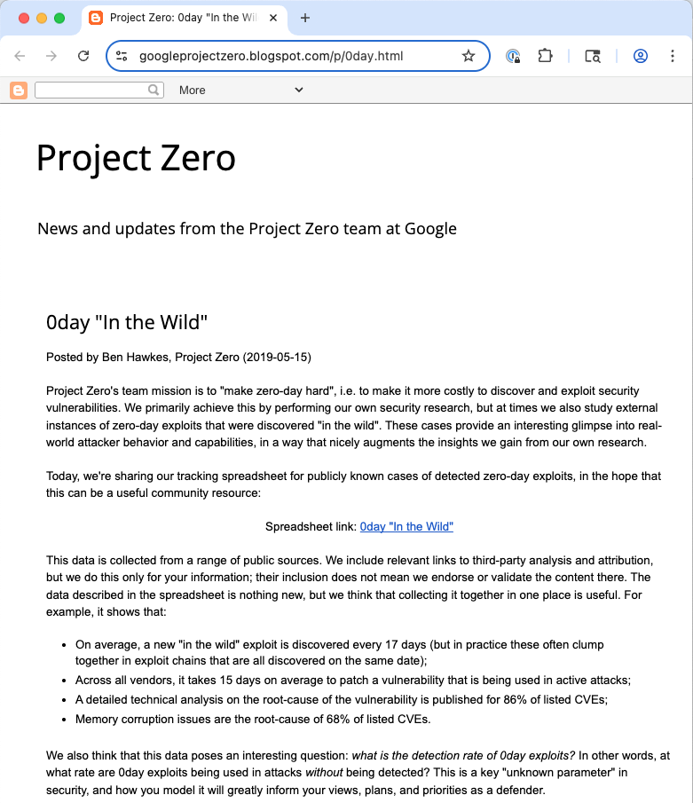
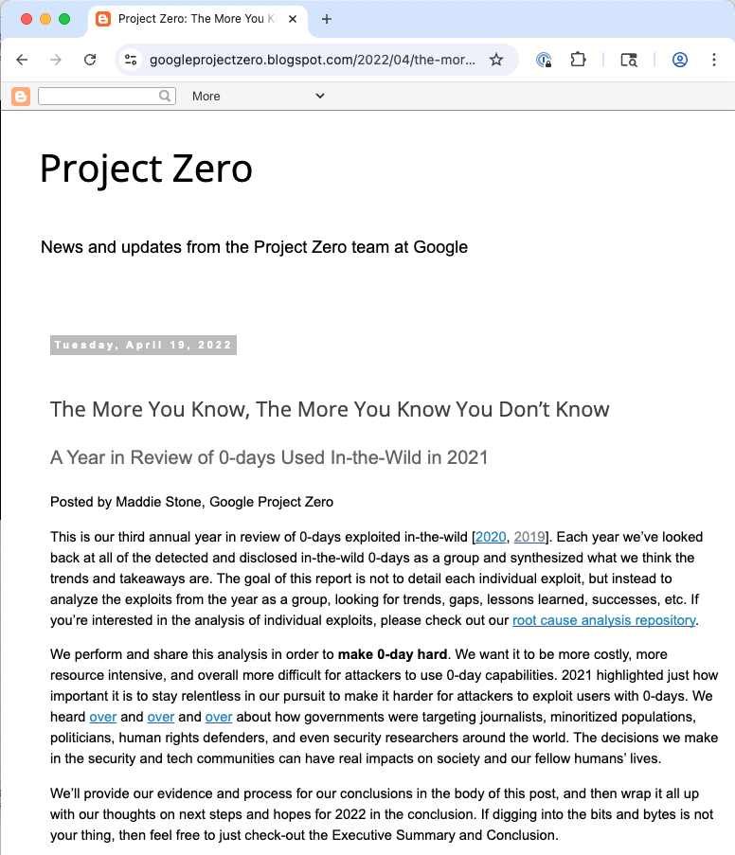
How’s that going?

Slide 23
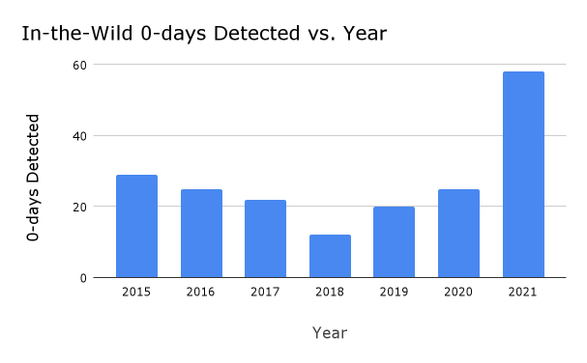
How’s that going?

Slide 24
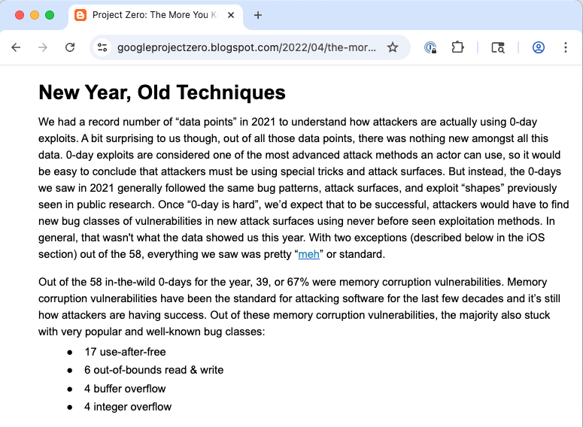
How’s that going?
Out of the 58 in-the-wild 0-days for the year, 39, or 67% were memory corruption vulnerabilities.

Slide 25
How’s that going?
Lots we don’t know
No estimate of the damage caused by the exploitation
Data is lower bound – probably more exploited zero-days than these (not known, not reported)
Zero-days are not the only vector of attack

Slide 26
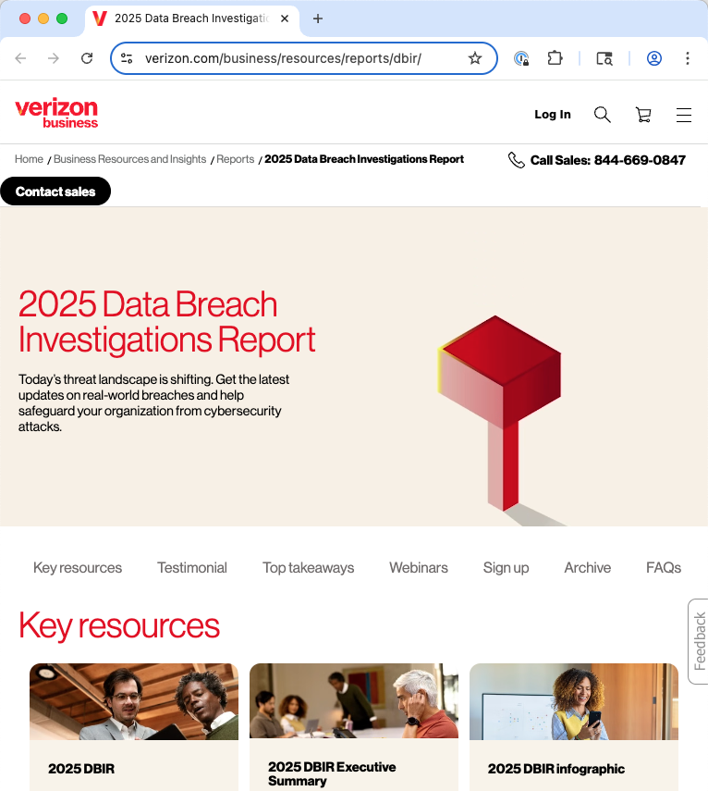

Slide 27
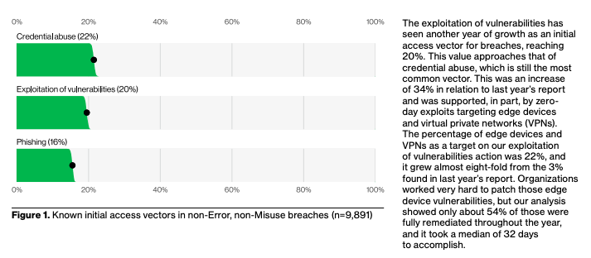
The exploitation of vulnerabilities has seen another year of growth as an initial access vector for breaches, reaching 20%. This value approaches that of credential abuse, which is still the most common vector.

Slide 28
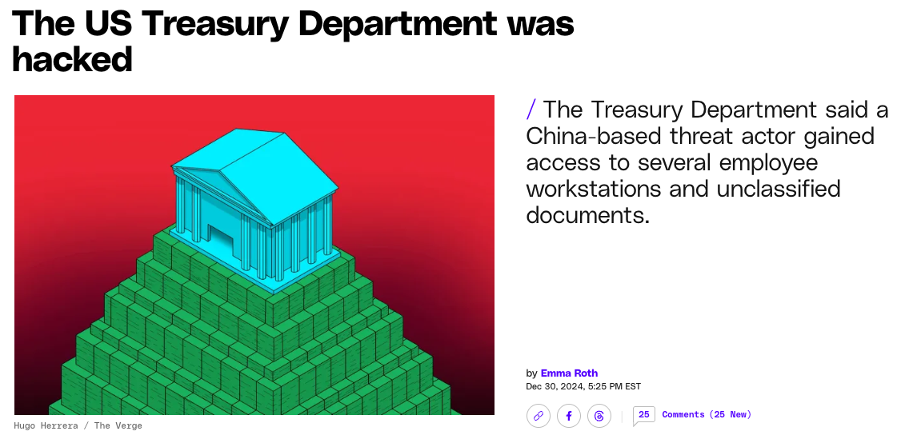
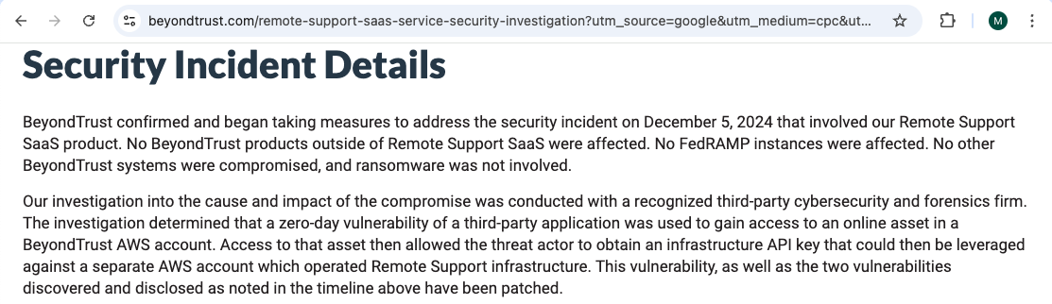
… “gain access to an online asset in a BeyondTrust AWS account. Access to that asset then allowed the threat actor to obtain an infrastructure API key …” which was used to operate the Remote Support infrastructure
Notes:
a zero-day vulnerability of a third-party application was used to gain access to an online asset in a BeyondTrust AWS account. Access to that asset then allowed the threat actor to obtain an infrastructure API key that could then be leveraged against a separate AWS account which operated Remote Support infrastructure.

Slide 29
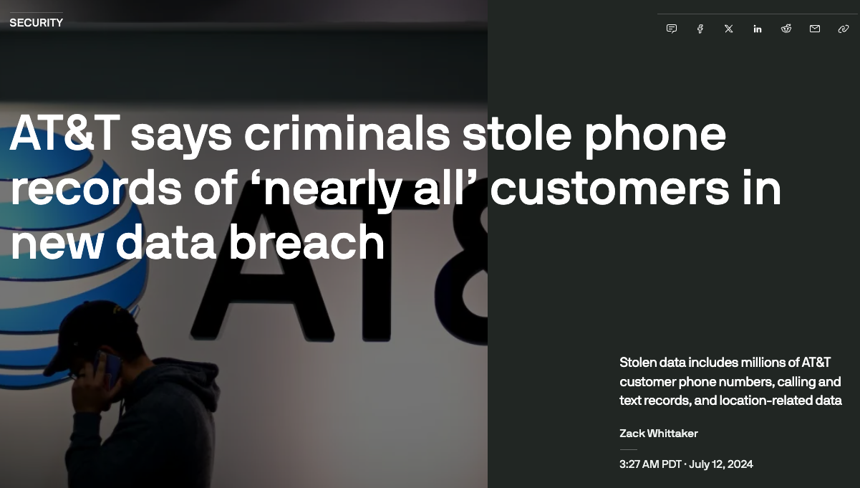
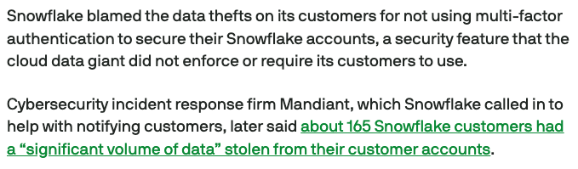
“Snowflake blamed the data thefts on its customers for not using multi-factor authentication to secure their snowflake accounts, … did not require its customers to use”

Slide 30
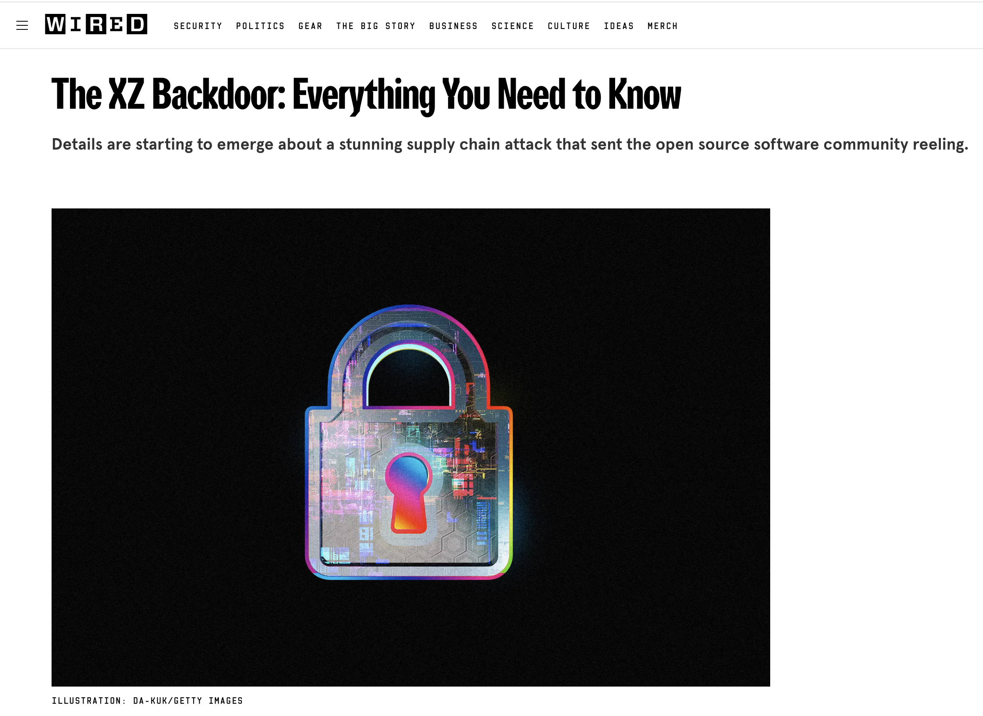
“This might be the best executed supply chain attack we've seen described in the open, and it's a nightmare scenario: malicious, competent, authorized upstream in a widely used library"
Notes:
Insider threat blow by blow https://boehs.org/node/everything-i-know-about-the-xz-backdoor

Slide 31
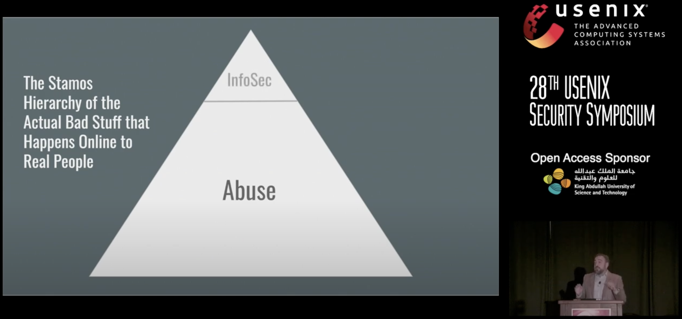
The big picture
https://www.usenix.org/conference/usenixsecurity19/presentation/stamos

Slide 32
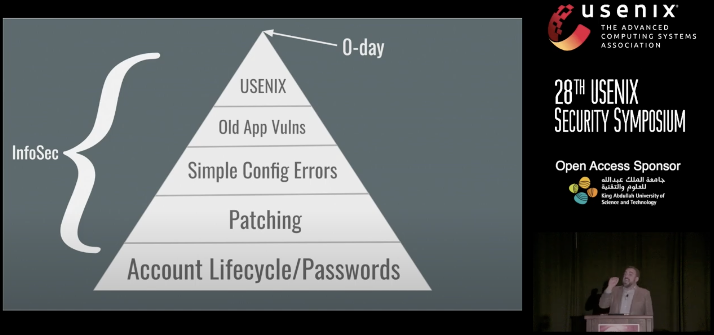
The big picture
https://www.usenix.org/conference/usenixsecurity19/presentation/stamos

Slide 33
So: What would you do?
If you were a CISO, or a VP of Security Engineering, how would you spend your money?
If you were the head of a government agency like CISA, tasked with improving the state of cybersecurity, what would you recommend?
If you were the head of NSF’s Secure and Trustworthy Cyberspace program, what would you fund?

Slide 34
Empirical Security & Privacy, for Humans
UPenn CIS 7000-010

Slide 35
Goals for the course
Learn the research state of the art

Slide 36
Economic view of cybersecurity
End users and cybersecurity
Cybersecurity as a scientific pursuit
Cybersecurity investment as risk assessment
Cybersecurity game theory
Cyberattack economics
Cybersecurity public health
Developers’ and operators’ actions, and security
Ethics in computer security experimentation
Network-based security measurement
Privacy

Slide 37
Goals for the course
Learn the research state of the art
Learn relevant research methods
Learn how to learn – how to dive into a field, understand its results, and see gaps and opportunities
Do something interesting: New result, reproduction, or a deep dive

Slide 38
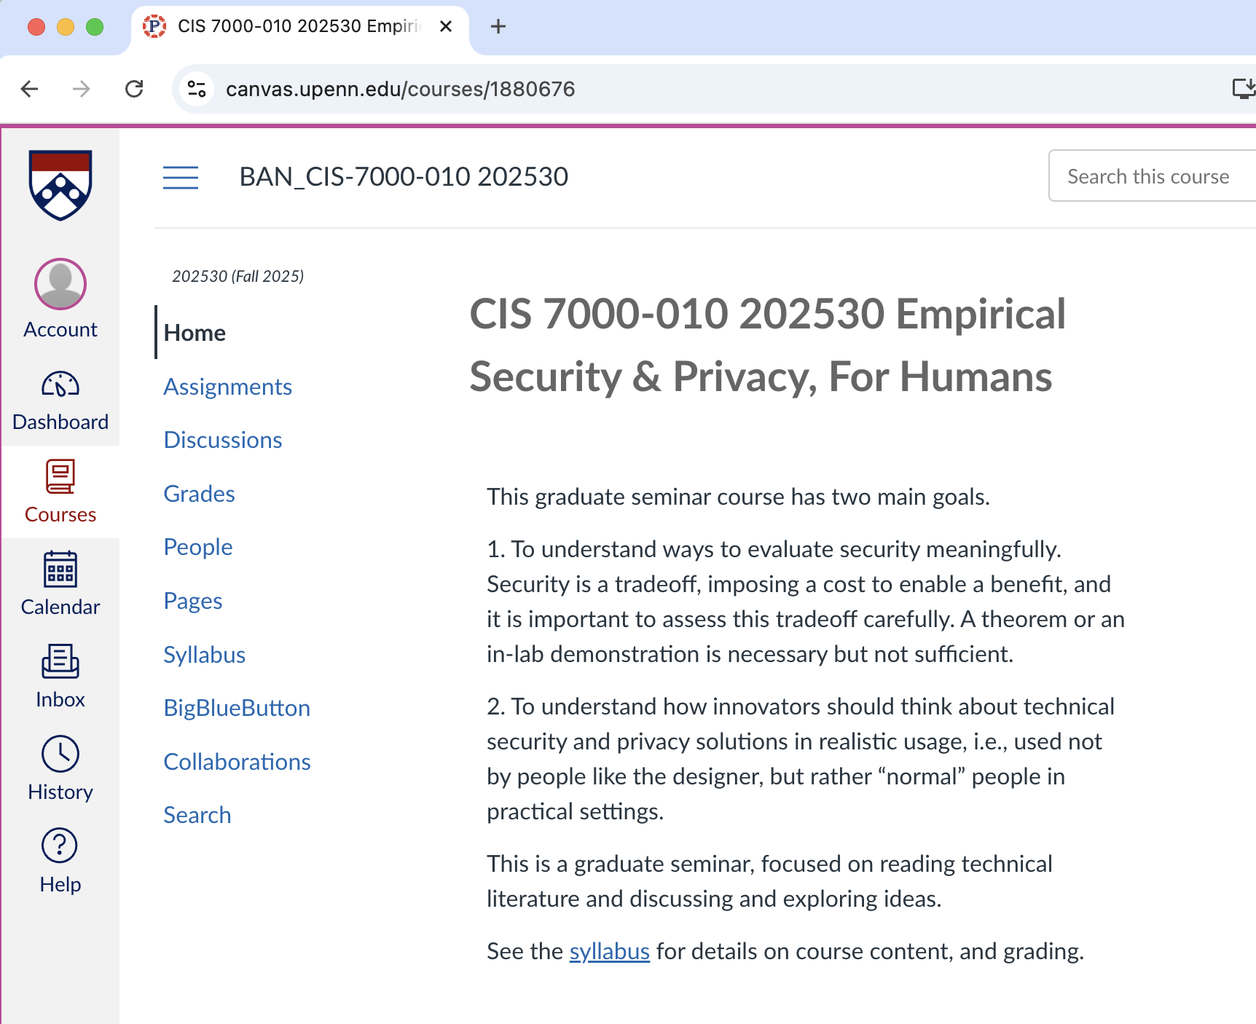
https://canvas.upenn.edu/courses/1880676

Slide 39
Approach
Read papers, (sometimes) present them, critique them, discuss
Learn from experts in the field
Do a (group) project
We will have Zoom enabled during the class, for remote lectures and for those who (occasionally) can’t make it

Slide 40
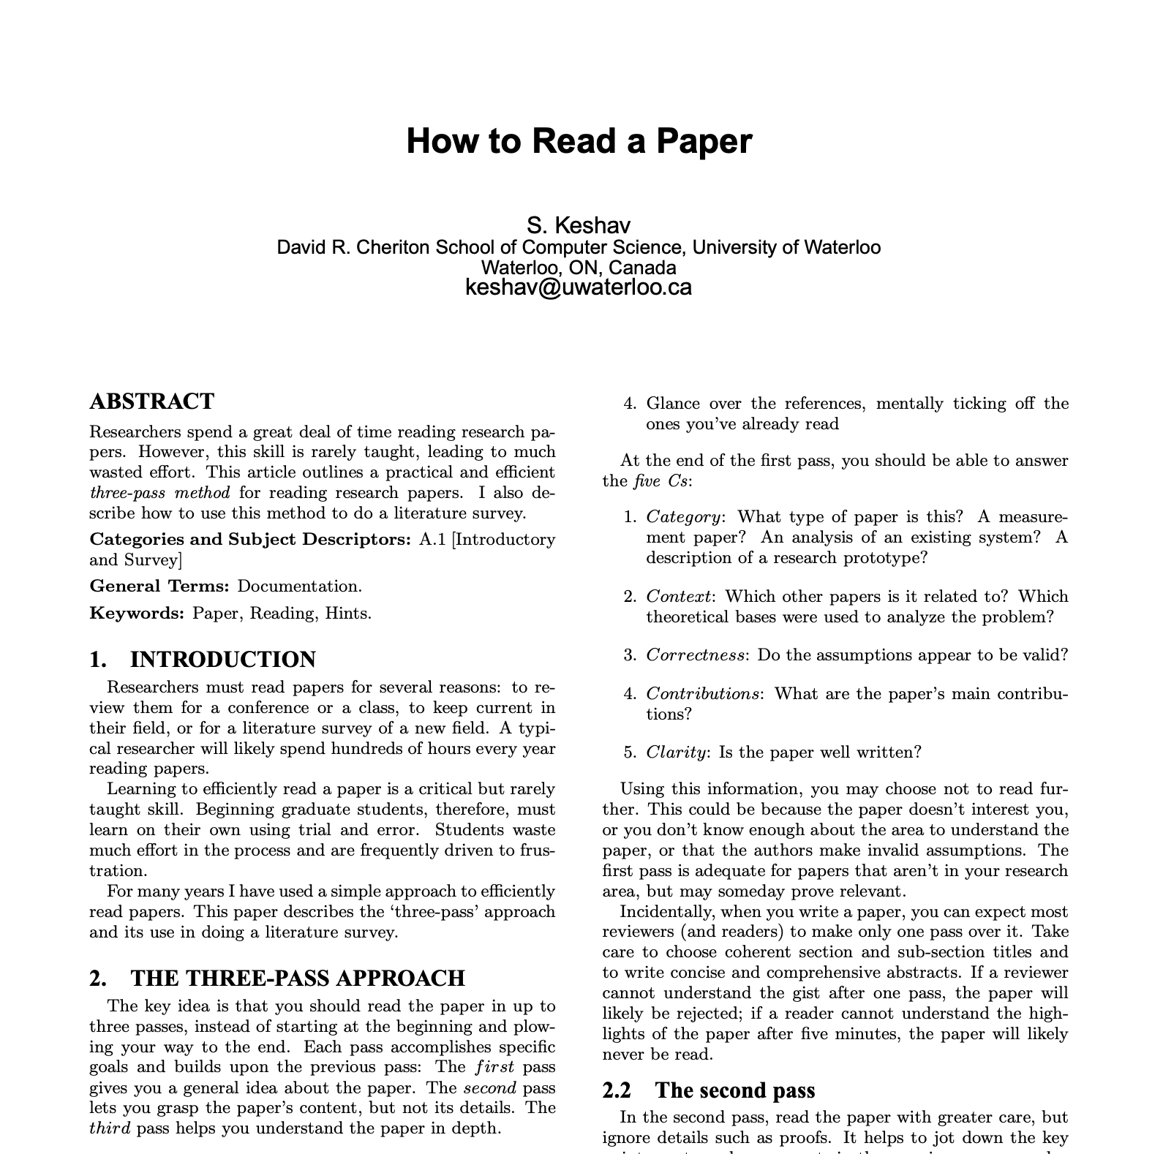
Read papers: Question, understand, improve

Slide 41
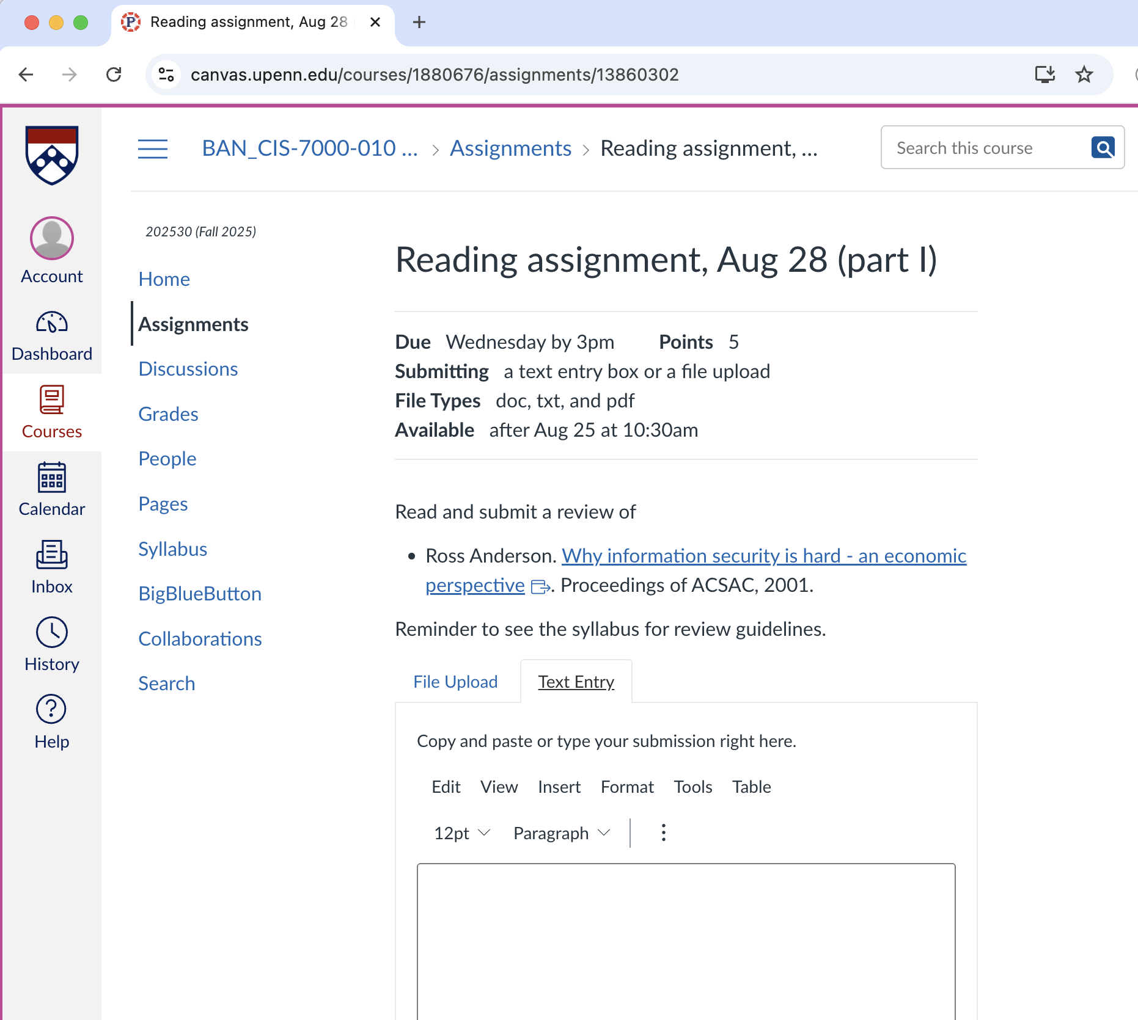
Class prep
Read the paper(s) for that class. Submit a 1-2 paragraph review

Slide 42
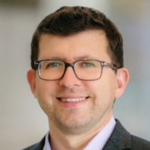
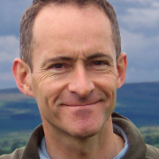
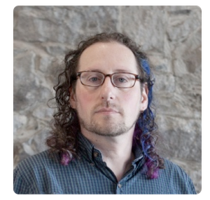
Guest lectures (so far)
Alex Gantman
VP, Security Engineering, Qualcomm, August 28
Cormac Herley
VP, Security Engineering, Qualcomm, September 4
Adam Shostack
Founder & CEO, Shostack & Associates, October 7

Slide 43
Present papers: Distill, reveal, dive deep
Will do this for the second half of the class
We will vote on a pool of papers to present, and you can select the 1 you want
Grading criteria: Understanding, thoughtfulness, background/perspective, clarity, materials quality, delivery, non-regurgitation, answering questions

Slide 44
Projects
Something substantial: New study, reproduction, literature review, …
Timeline
Pitches in class @ 9/25
Proposal @ 10/9
Final paper @ finals week

Slide 45
About me
Ph.D., CIS @ UPenn 2001
Remained a Philly sports fan (go Eagles!)

Slide 46

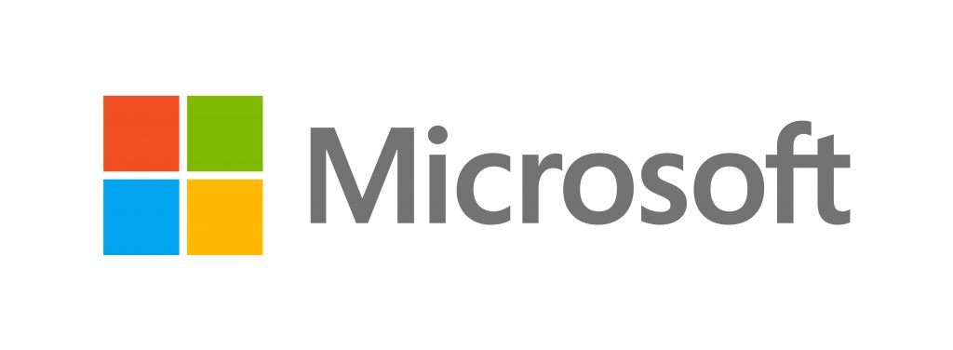






About me
Employment
Selected leadership positions
2002-2022 – TTk faculty, UMD
2006-2015 – Adjunct, IDA/CCS (NSA-funded research lab)
2008, 2015 – Visiting Researcher, Microsoft Research
2018-2021 – CTO, Correct Computation, Inc (startup)
2022-present – Senior Principal Scientist, AWS
2009-2012 – Member, DARPA Information Science and Technology Board
2011-2013 – Director, Maryland Cybersecurity Center
2015-2018 – Chair, ACM Special Interest Group on Programming Languages
2017-2021 – Assoc. Chair, Undergrad Education, UMD CS

Slide 47
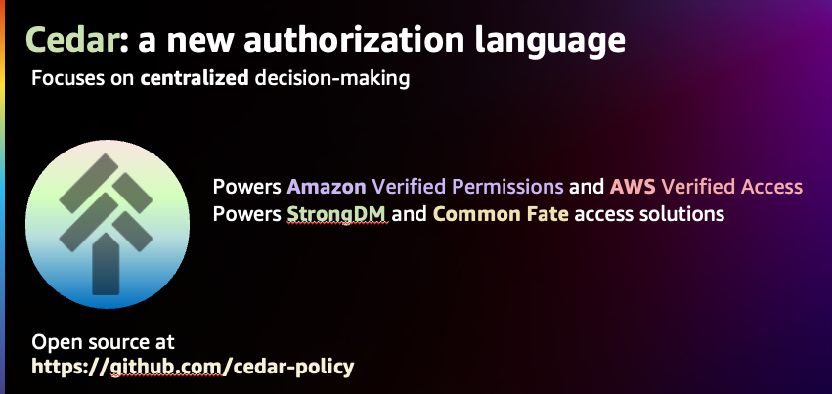
About me
Research @ UMD: Software Security, Programming Languages, Software Engineering, Usability, Cryptography, Quantum Computing, Networks, Databases
Startup: Building tools for secure software development
Binary analysis
Migration to memory-safe C
AWS
Cedar authorization language
Fuzzing/automated test generation
Formal/mechanized proofs of security

Slide 48
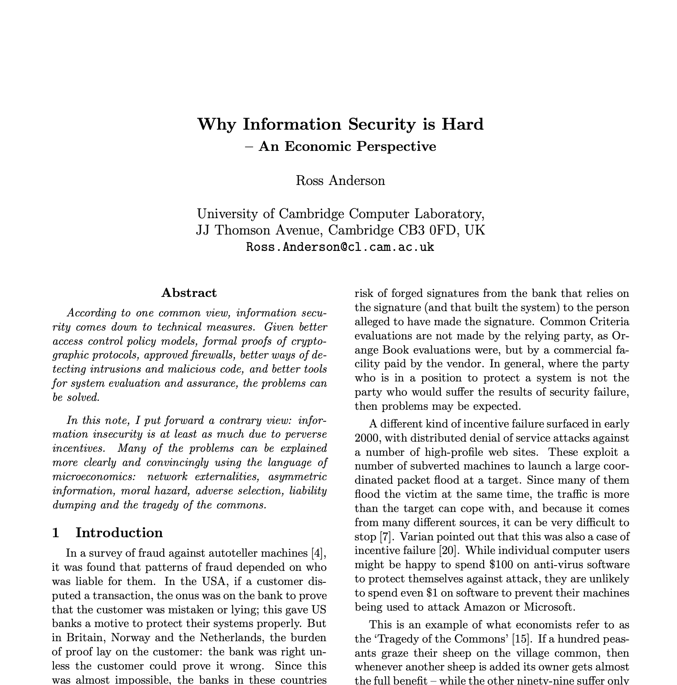
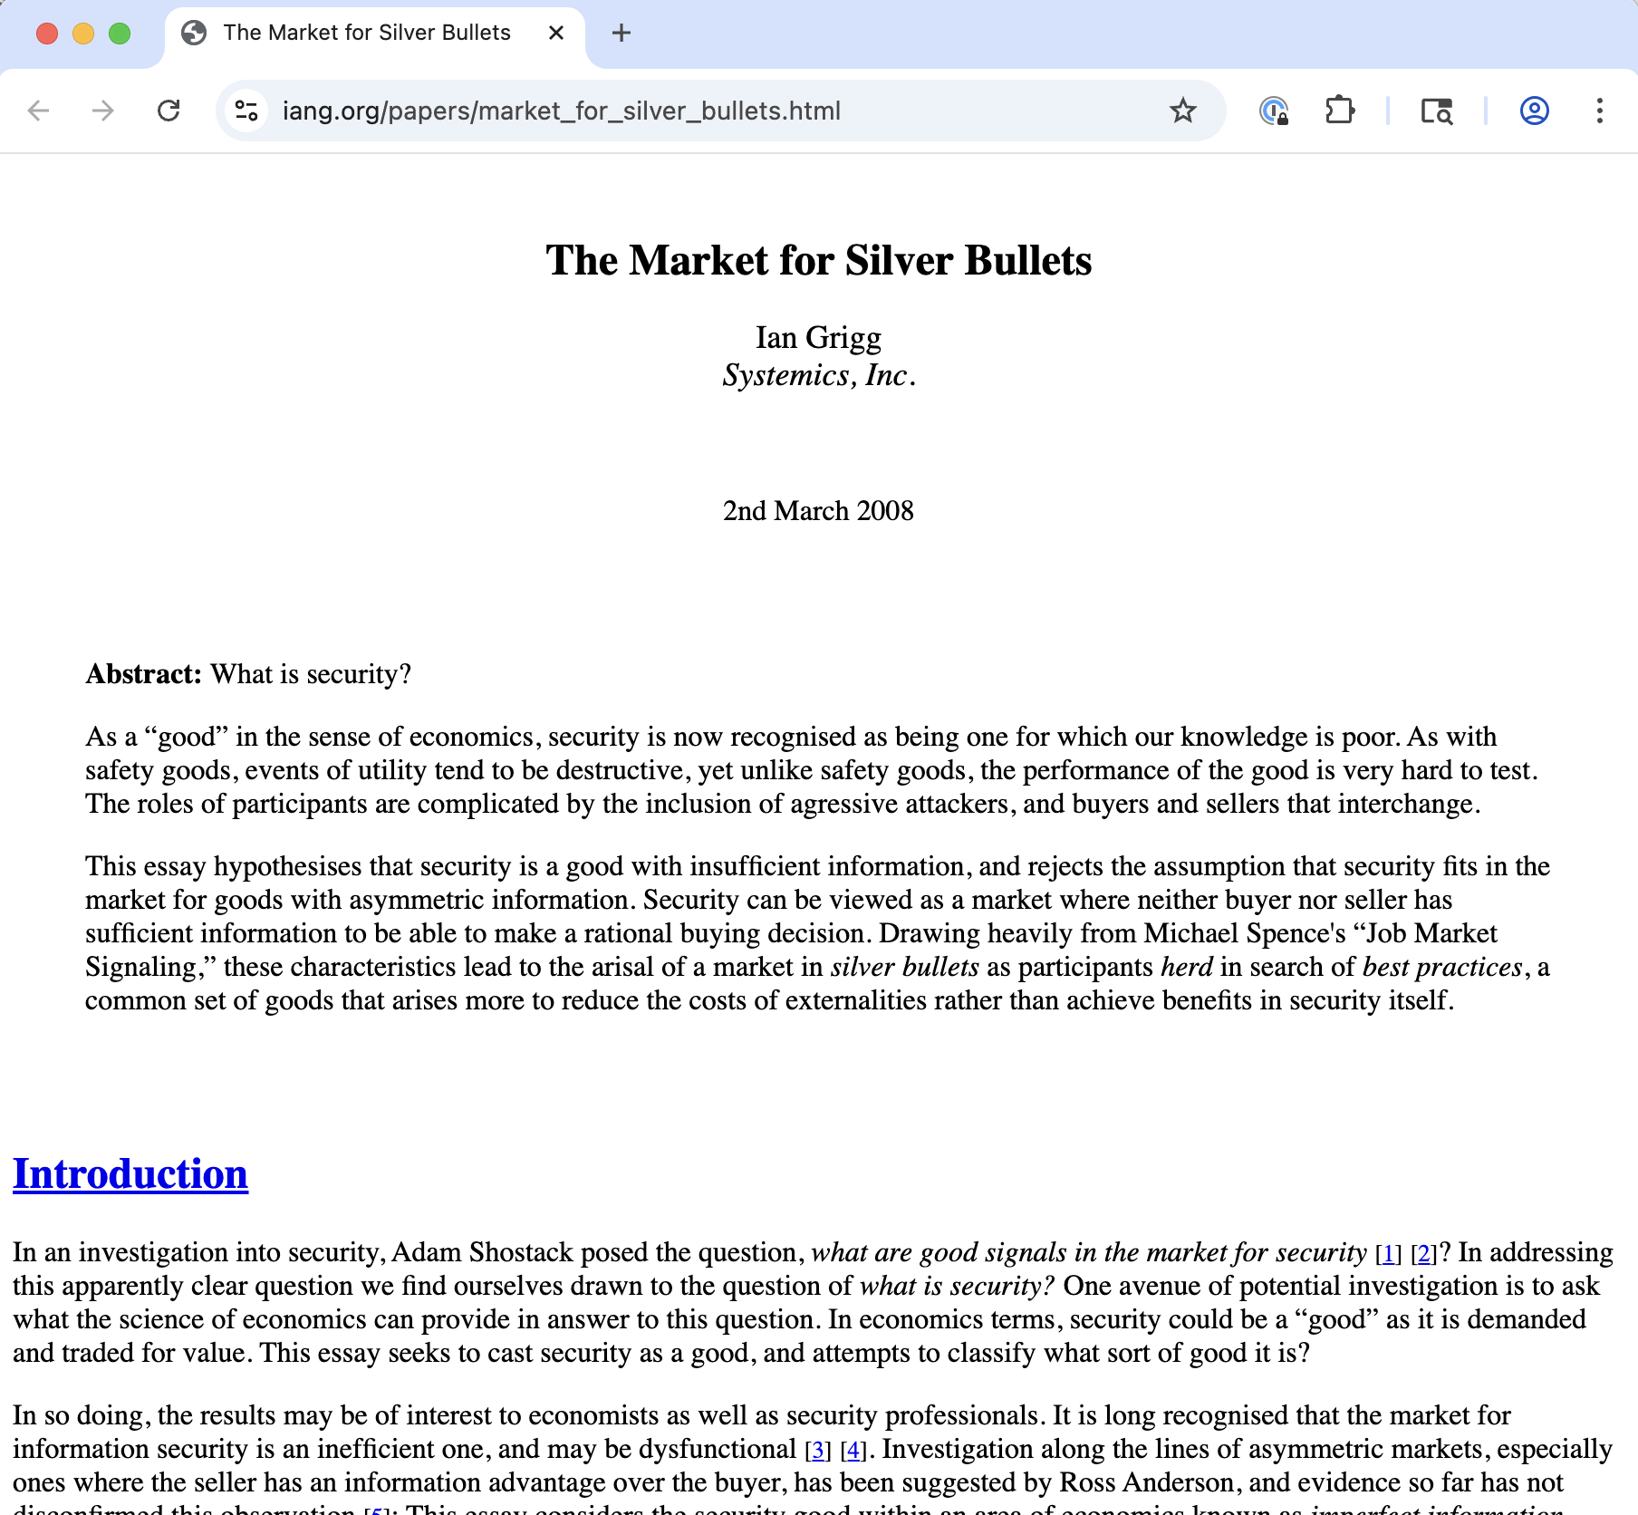
Reading for next time
Plus: “How to Read a Paper?”

